Slide 1
Quantum Game: Quantum Dots and Boxes
QPloand Global Quantum Hackthon 2024 Jianfei Yang, Gaoming Fan

Slide 2
Contents
Dots and Boxes Game rules
Grover used in Dots and Boxes
Demo Display

Slide 3
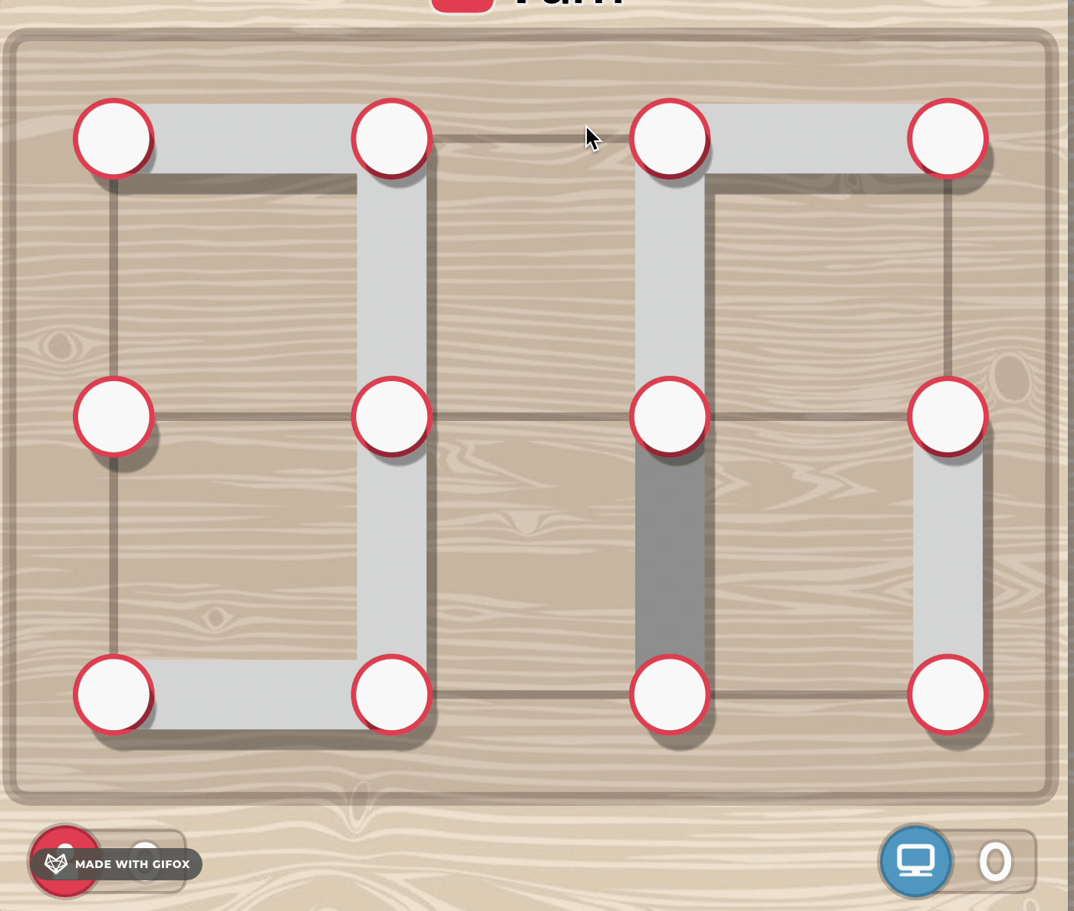
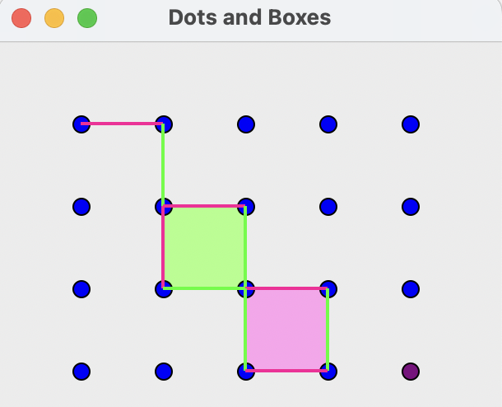
Dots and Boxes Game Rules
two players take turns connecting dots on a grid of a fixed size. When a player completes a closed square, they earn an extra turn. At the end of the game, the player with the most squares wins!

Slide 4
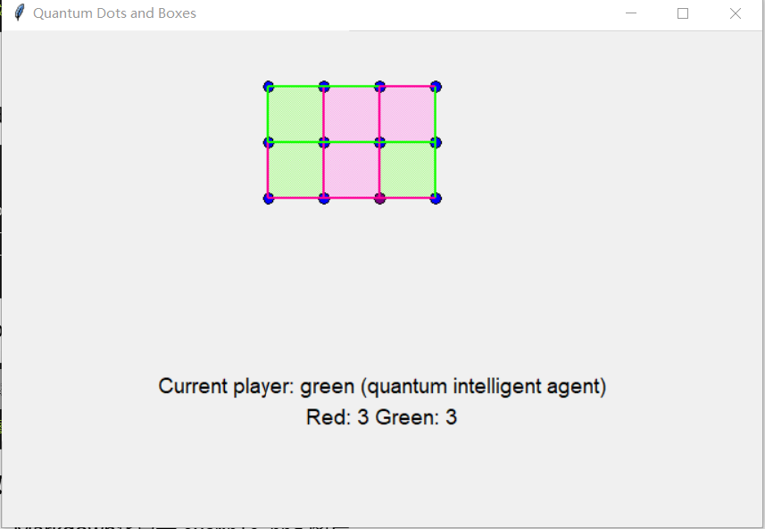
Quantum Dots and Boxes
Why we choose Dots & Boxes?
1. Search Algorithm will be enough to play the role of opponet
2.Board Size can be changed! Which will be more friendly for NISQ Quantum Computer to run with less qbits needed!

Slide 5
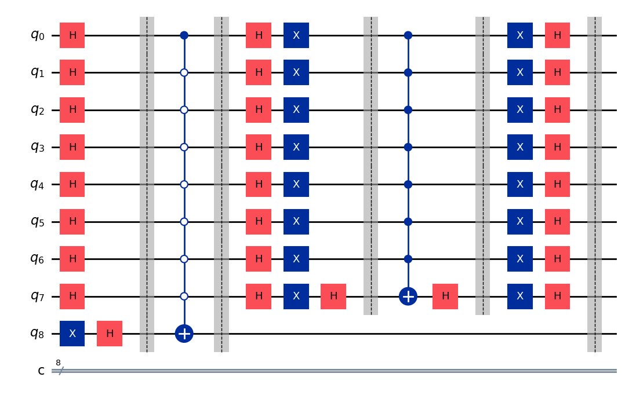
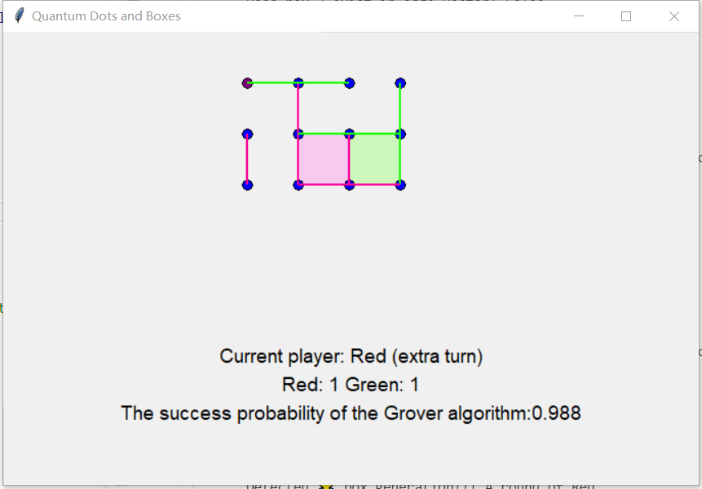
Quantum Dots and Boxes
Core issue:
1. How to represent a grid chess face based on quantum circuits?
2. How to set up an Oracle Operator?
3. How to calculate Repeat Times?

Slide 6
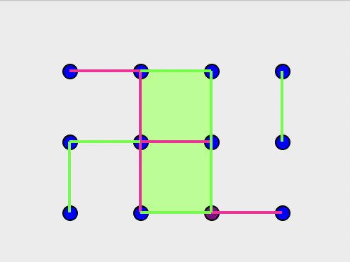
Quantum Dots and Boxes
1. Using qubit to encode chessboard states
The state of each line can be represented using quantum states. State 1 can be considered as the line being connected, while state 0 indicates that the line is not connected
M x N Dots and Boxes
have Q = (M+1)*N + (N+1)*M lines
Up to Q qubits can be used
line vector :[1, 1, 1, 0, 0, 0, 1, 0, 1, 0, 0, 0]

Slide 7
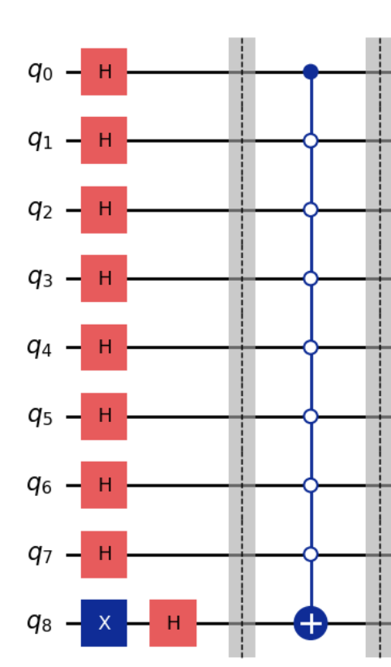
Quantum Dots and Boxes
2.Oracle design
What states does Oracle want to filter：
1.The situation where quantum intelligent agents can form a box in the next step
2.If requirement 1 is not met, search for situations where the next step (opponent) cannot form a box
How to get it
Based on simple graph theory rules.
According to the Oracle circuit on the right, the step represented by the phase reversal of |00000001>state |00000001> will be our best choice.

Slide 8
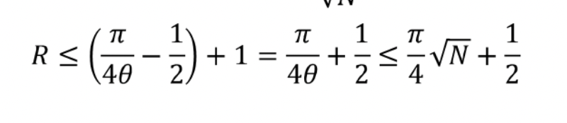
Quantum Dots and Boxes
3. Determination of repetition times R

Slide 9
Quantum Dots and Boxes：
Summary:
Human players take the lead, quantum agents begin Grover search for the next move
During this process, qubits based chessboard state encoding, Grover circuit construction, and determination of repetition times will be completed
After the final construction of the quantum Grover search algorithm circuit, all bits except for the auxiliary bit will be measured, and only a small number of times (at least 1) will be taken. The quantum state with the most occurrences will be selected as the next decision

Slide 10
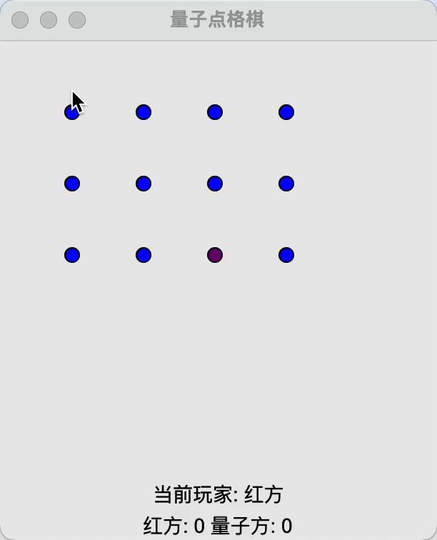
Demo:
Human: Red
Quantum intelligent agent: Green
Chessboard size: 2X3
Final result: Quantum intelligent agent wins!

Slide 11
Instructions for code, development framework, GUI
- This scheme is implemented based on programming frameworks such as Qiskit and isqtool
- The measurement results of Grover algorithm are implemented based on
Qiskit's StatevectorSampler simulator
- GUI based on tkinter

